Slide 1
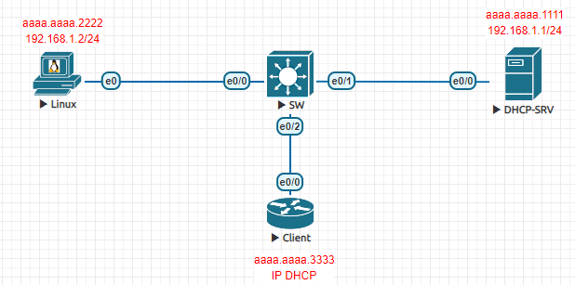
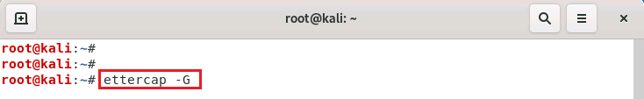
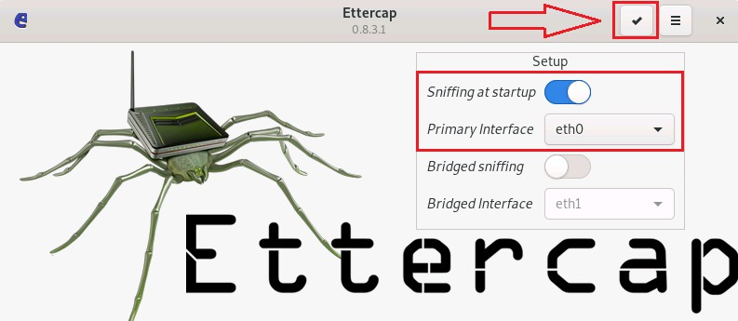
ARP Poisning or Spoofing Attack:
Lets start Ettercap graphically type below command in Kali Linux Terminal.
Now, click on tick mark to start Unified Sniffing on Kali Linux.

Slide 2
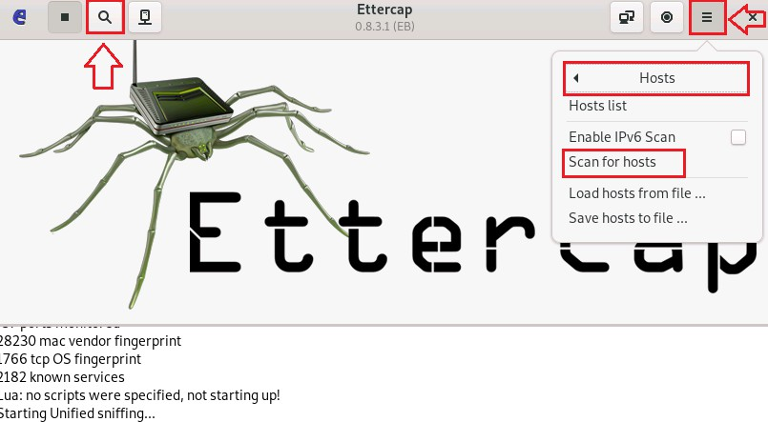
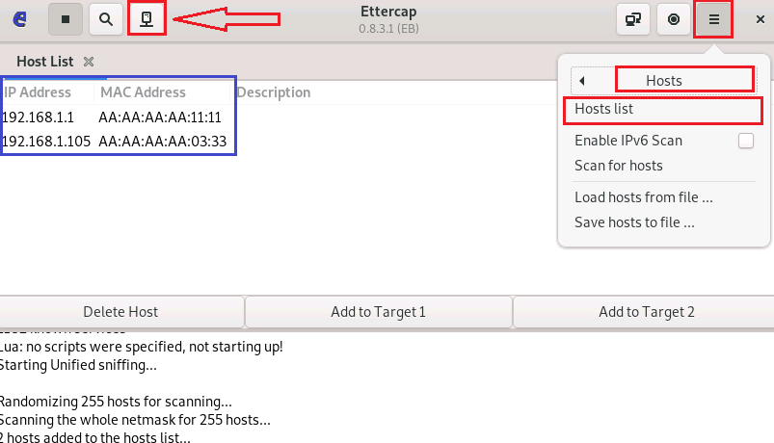
Click to Scan for Hosts in the Network you can use shortcut menu as well.
Click to display Scan Host Lists you can use shortcut button on menu as well.

Slide 3
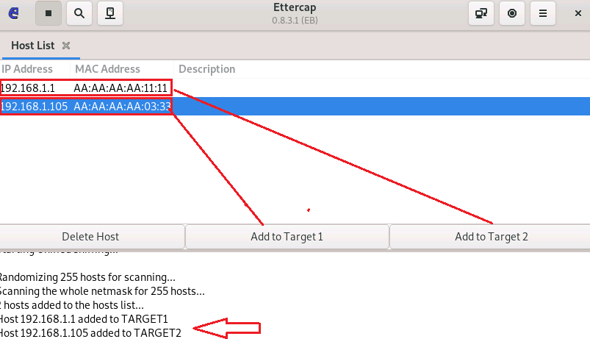
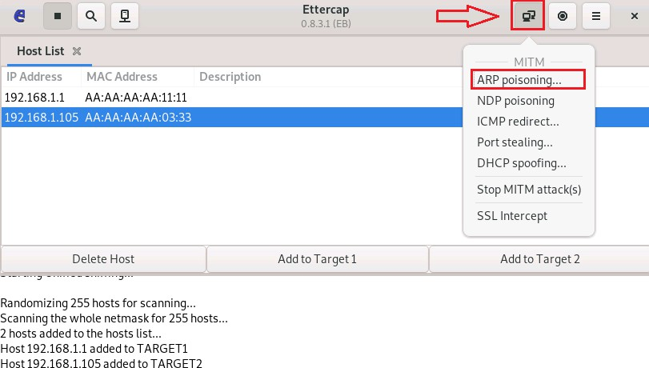
Click to Add to Target 1 and Add to Target 2 to make it ready for MITM attack.
Click to start ARP Poisoning attack on the give Target Systems.

Slide 4
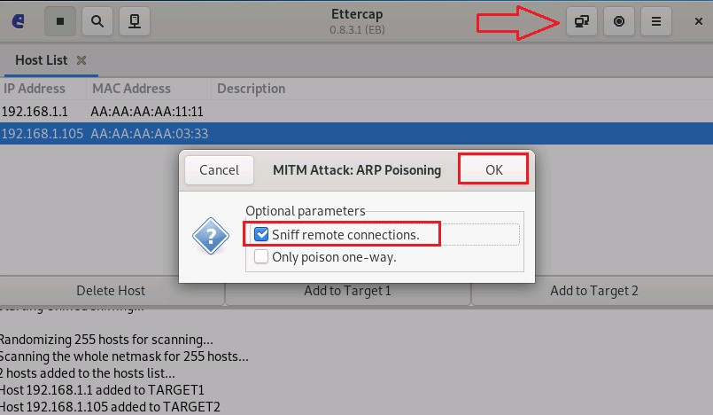
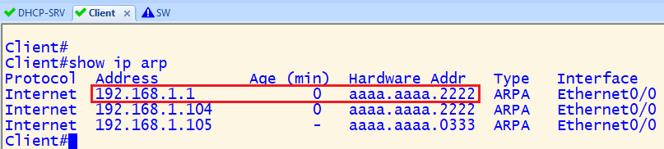
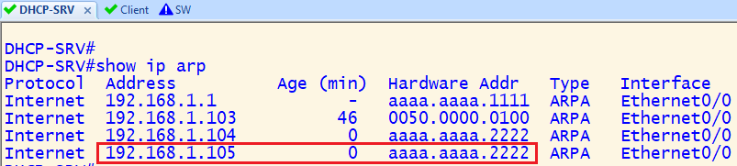
Select Sniff Remote Connections and press OK to start ARP Poisoning Attack.
In Client system front of DHCP-SRV it is showing Kali Linux MAC Address.
And In DHCP-SRV system front of Client System it is showing Kali Linux MAC Address.
2nd Method for ARP Spoofing Attack first command is Kali Linux start work as a router.
root@kali:~# echo 1 > /proc/sys/net//ipv4/ip_forward
root@kali:~# arpspoof -i eth0 -t 192.168.1.105 -r 192.168.1.1

Slide 5
Dynamic ARP Inspection:
DAI stands for Dynamic Address Resolution Protocol Inspection.
DAI is a security feature that rejects invalid and malicious ARP packets.
DAI feature prevent man-in-the-middle attacks such as ARP poisoning.
DIA feature prevent man-in-the-middle attack such as ARP Spoofing.
DAI relies on Dynamic Host Control Protocol (DHCP) snooping feature.
DHCP snooping builds binding database of valid MAC address, IP & VLAN interface.
DAI uses the DHCP snooping binding database to validate bindings.
Dynamic ARP Inspection (DAI) verifies IPv4 address to MAC address bindings.
If mismatch happened on untrusted port, DAI will discard spoofed ARP packets.
Dynamic ARP Inspection (DAI) only inspects ARP packets from untrusted ports.
Dynamic ARP Inspection (DAI) can be enabled globally per VLAN.
Before Apply Dynamic ARP Inspection (DAI) it require below Configuration.
DHCP SERVER Configuration
DHCP-SRV(config)#interface ethernet0/0 DHCP-SRV(config-if)#ip address 192.168.1.1 255.255.255.0 DHCP-SRV(config-if)#mac-address aaaa.aaaa.1111 DHCP-SRV(config-if)#no shutdown
DHCP-SRV (config)#ip dhcp excluded-address 192.168.1.1 192.168.1.100 DHCP-SRV (config)#ip dhcp pool TEST DHCP-SRV (dhcp-config)#network 192.168.1.0 /24
DHCP-SRV # show ip dhcp binding
DHCP Client Configuration
Router(config)#hostname client client(config)#interface ethernet0/0 client(config-if)#mac-address aaaa.aaaa.3333
client(config)#interface ethernet0/0 Client(config-if)#no ip address Client(config-if)#ip address dhcp
Client# show ip int br
Kali Linux Configuration
root@kali:~# ifconfig eth0 192.168.1.2 netmask 255.255.255.0 root@kali:~# macchanger -m aa:aa:aa:aa:22:22

Slide 6
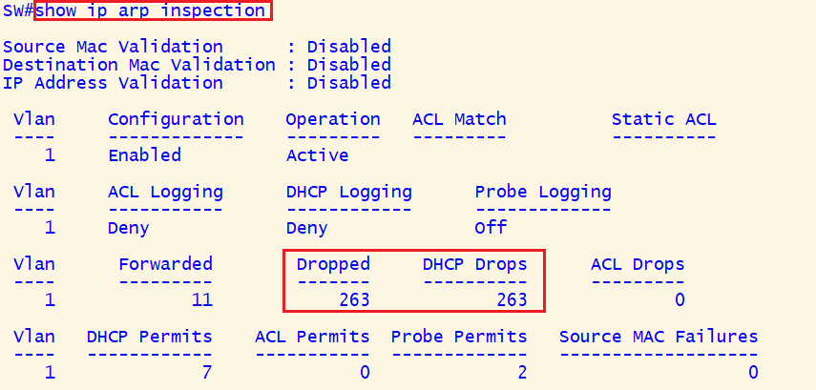
DHCP Snooping Configuration SW
SW(config)#ip dhcp snooping
SW(config)#ip dhcp snooping vlan 1
SW(config)#interface Ethernet 0/1 SW(config-if)#ip dhcp snooping trust
SW(config-if)# no ip dhcp snooping information option
SW(config)#interface Ethernet 0/1 SW(config-if)# ip dhcp snooping limit rate 100
SW(config)#interface range Ethernet 0/0, Ethernet 0/2 SW(config-if)# ip dhcp snooping limit rate 20 (20 packets per second)
SW# show ip dhcp snooping binding
SW# show ip dhcp snooping
SW# show ip dhcp snooping statistics
Dynamic ARP Inspection Configuration SW1
SW(config)#ip arp inspection vlan 1
SW(config)# interface Ethernet 0/1 SW(config-if)# ip arp inspection trust
SW# show ip arp inspection
Change Client IP Address
Client(config)#interface e0/0 Client(config-if)#ip address 192.168.1.103 255.255.255.0
Client# ping 192.168.1.2
Client(config)#interface e0/0 Client(config-if)#ip address dhcp

